Slide 1


Kafka Fundamentals
Notes:
Kafka Fundamentals: A presentation about the fundamental concepts a developer has to understand in order to develop Kafka-based applications

Slide 2


Agenda
01. Introductions
02. Pre-Requirements
03. The Origin of the Name
04. The Kafka Paradigm
05. Fundamental Kafka Concepts
06. Lab Time
07. Kafka CLI Tools
08. Kafka Related Projects
09. A Note on Serialization
10. Final Quiz

Slide 3

1. Introductions

Slide 4


About me
xavier.araujo92@gmail.com
linkedin.com/in/xavier-araujo
xavieraraujo.github.io

Slide 5
And what about you? 😊

Slide 6
2. Pre-Requirements

Slide 7

Pre-Requirements
GIT
Maven
IDE
Docker/Docker-Compose/Rancher/Podman
Kafka-client tools

Slide 8
3. The Origin of the Name

Slide 9

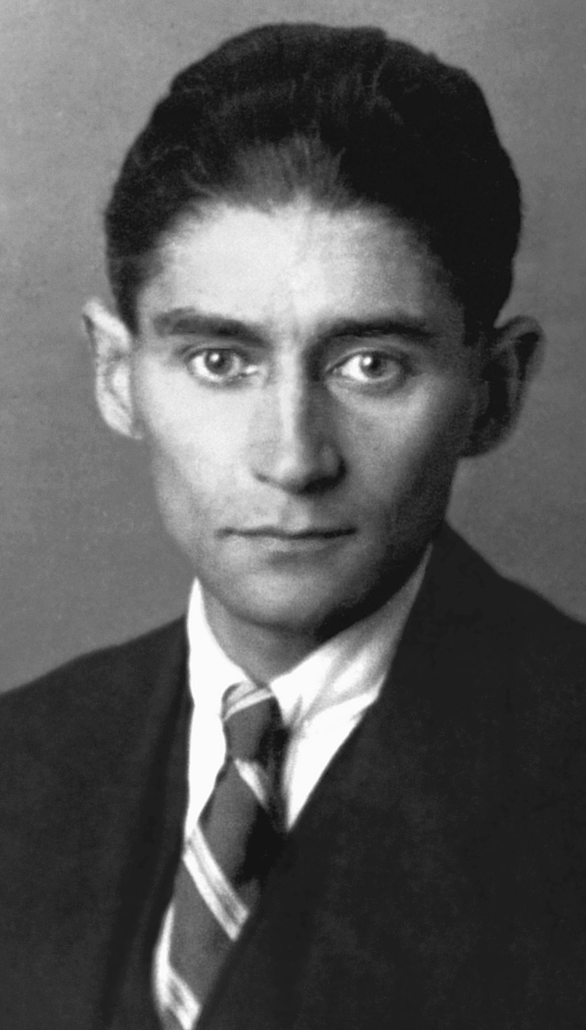

Franz Kafka
Notes:
Jay Kreps (software engineer at LinkedIn and now on Confluent) chose to name the software after the author Franz Kafka because it is "a system optimized for writing", and he liked Kafka's work.

Slide 10
4. The Kafka Paradigm
Notes:
Describe the section:
- We will dive into a bit of system design to understand why is a paradigm like Kafka necessary and in what does it consists.

Slide 11
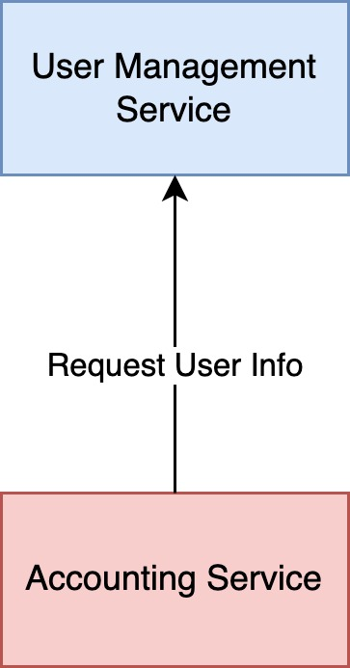
A simple use case arises
Synchronous Communication
HTTP Requests
RPC/RMI (Remote Procedure Calls/Remote Method Invocation)
Non-Reactive System
Notes:
1. Describe the system:
- The accounting service needs to know information related to the users so it queries the user management service directly
- The accounting service only needs the information in certain moments in time.
2. Talk about the characteristics of the system:
- Synchronous communication (blocking system)
- Non-Reactive System: it is ok for this particular use-case
3. Questions:
- What it means to be synchronous communication?
- It blocks waiting for the information. This means that when a client makes a request to the server, it waits for the server's response before proceeding.
- The client is blocked until the server processes the request and sends back the response.
- What it means to be non-reactive?
- We don’t react to user changes/creations.
- We need to request user information when we need it
- If we need to receive up-to-date information we need to do implement a polling strategy
- Do you know what RPC is?
- Making function calls that execute in remote servers and that hide all the details of the remote interaction

Slide 12
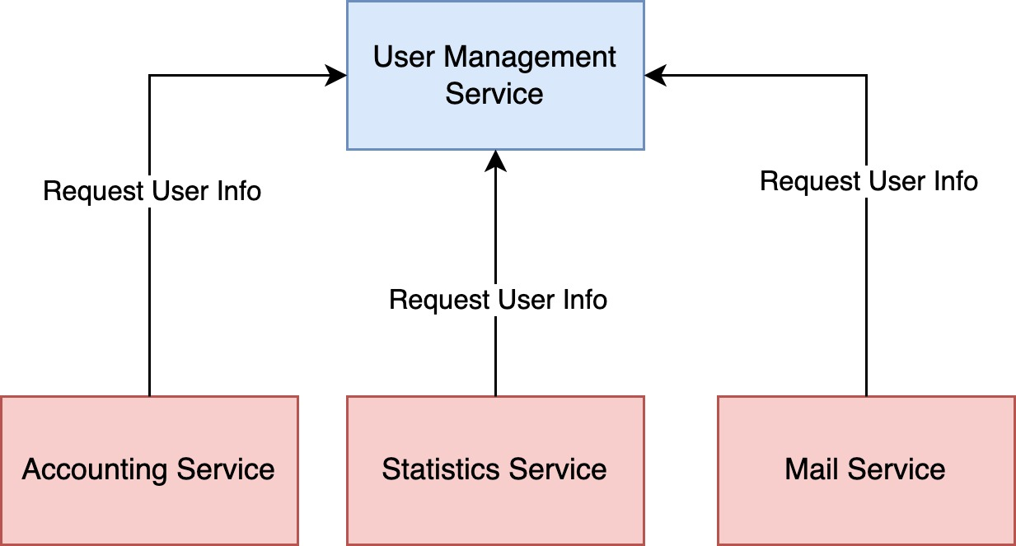
The system grows
Synchronous Communication
HTTP Requests
RPC/RMI (Remote Procedure Calls/Remote Method Invocation)
Non-Reactive System
Notes:
Describe the system: - The system starts growing and now we have three more services all consuming from the User Management service - The characteristics of the system are maintained independently of the requirements of the services fetching the data: synchronous and non-reactive

Slide 13
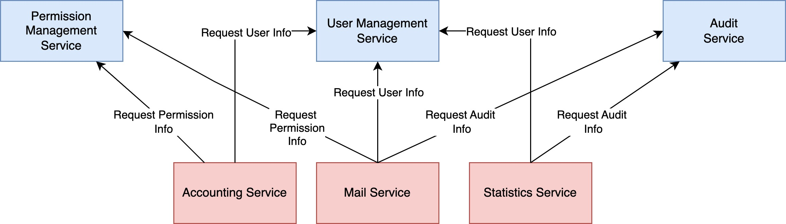
And continues growing
Synchronous Communication
HTTP Requests
RPC/RMI (Remote Procedure Calls/Remote Method Invocation)
Non-Reactive System
Notes:
Describe the system: - The system grows even more and now we have 2 more services providing data and we have an intricate system in terms of coupled dependencies - The characteristics of the system are maintained independently of the requirements of the services fetching the data: synchronous and non-reactive

Slide 14

What happens now?
Can you identify some possible problems with this architecture?
Harder to scale due to the synchronous nature of the system
Polling/Data Freshness
Harder to reason about the system
Coupling between producers and consumers
Cascading failure/Lack of self-sustainability
High technical debt
Notes:
Can you identify some possible problems with this architecture?
Harder to scale due to the synchronous nature of the system:
We cannot scale each service individually because it will impact the upstream services directly
Polling/Data Freshness
If we need to react to user information changes, we need to constantly poll the User Management Service. This really hurts scalability
Harder to reason about the system
A lot of direct coupling between dependencies
Coupling between producers and consumers
The consumer must know the producers and if the producers change the consumers will have to change also
Cascading failure:
If an upstream service fails the ones below will also fail due to the direct dependency
High technical debt:
The direct coupling increases technical debt

Slide 15
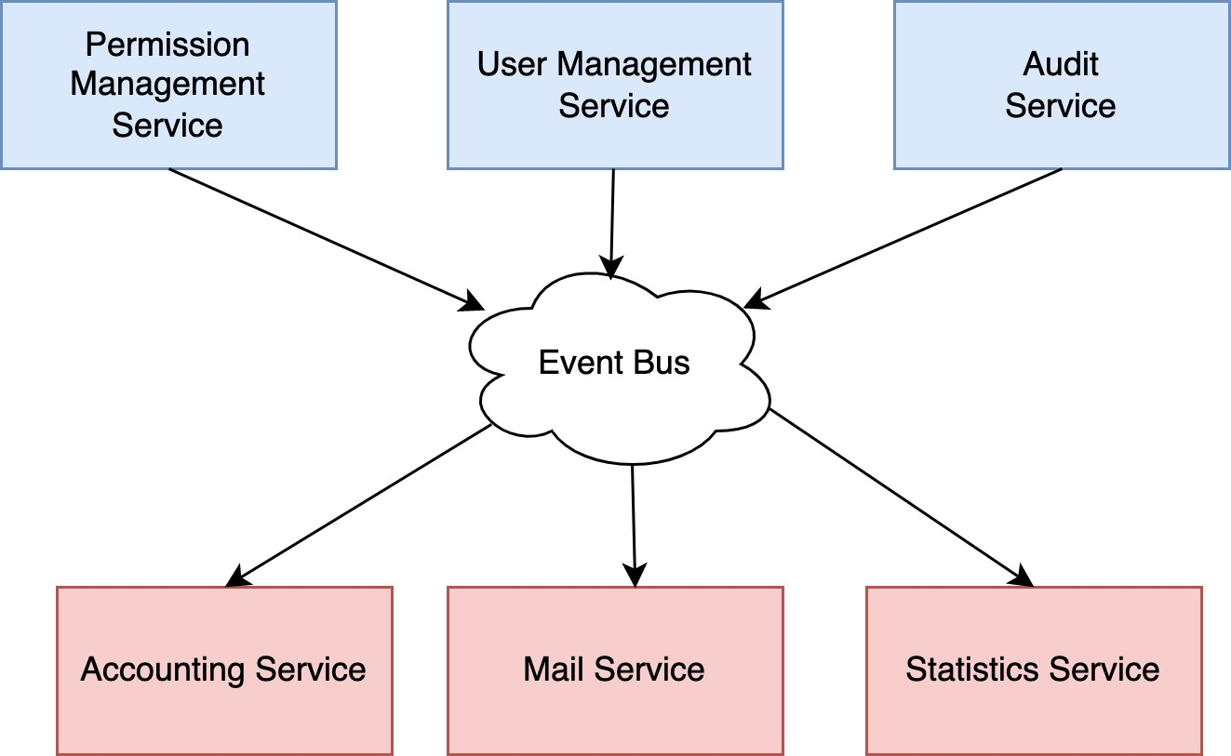
And a paradigm shift occurs
Can you identify some possible advantages?
Easier to scale due to the asynchronous nature of the system. Producers don’t need to grow with the consumers.
No more need for polling. We remove unnecessary requests and react faster to change
Easier to reason about the system
Decoupling between producers/consumer
Reduced possibility of cascading failure
Minimized technical debt
Notes:
We can add an event bus and send the required information through it. It could be a simple queue to where all events are sent.
Easier to scale due to the asynchronous nature of the system. Producers don’t need to grow with the consumers.
No more need for polling. We remove unnecessary requests and react faster to change
Easier to reason about the system
Decoupling between producers and consumers
Reduced possibility of cascading failure due to the decouple between producers and consumers
Due to the increased decouple between producers/consumers we minimize technical debt

Slide 16
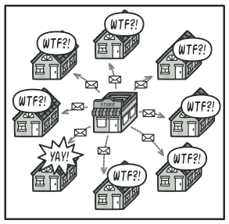
And a paradigm shift occurs
But now every service must process every event…
Notes:
All consumers process every event which will lead to unecessary load since most of the events will be discarded
It would be nice to have a way of indicating which events we care about and only be notified when one of those events arrives.

Slide 17
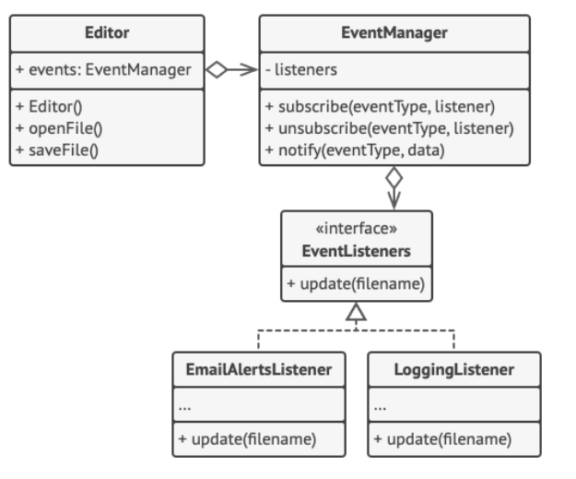
A small detour on design patterns
Does anyone know the observer design pattern?
Notes:
Discuss this design pattern. Ask if someone can explain it!
In the case of the observer
Do the parallel with the publish/subscriber architecture paradigm

Slide 18
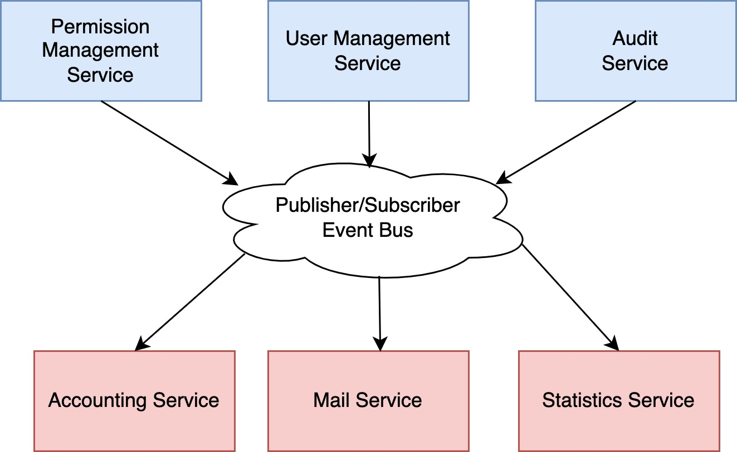
And we go a bit further
Now we can use the publisher/subscriber model to subscribe only the information we care about.
Notes:
The event bus implements the observer design pattern and knows which consumers want each event type

Slide 19

And we get to Kafka
Cluster based
Multiple producers/consumers
No producer/consumer coupling
Disk-based retention to promote asynchronous communication
Highly scalable and resilient
Real-time processing
Notes:
Kafka is at its core a publisher-subscriber systems which decouples data production from data consumption
We can have multiple producers/consumers to the same topic which would require too much coupling in the traditional HTTP based approach
No coupling because the producers don’t know who consumes the information and the consumers don’t know who produces the information. Producers/consumers can be added at will with no synchronization required.
Disk based retention: if the consumers are down the data will not be lost. They can consume it later.
Also was created for improved high write performance

Slide 20
5. Fundamental Kafka Concepts

Slide 21
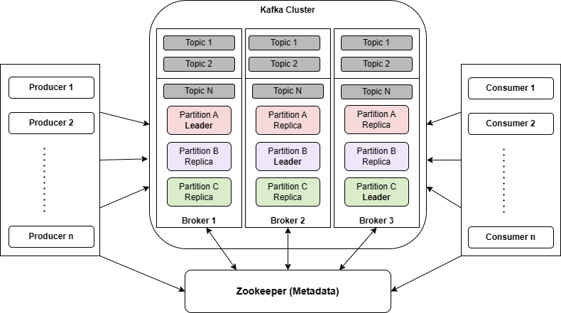
Kafka High Level Architecture
Producers
Consumers
Consumer Groups
Messages
Topics
Partitions
Notes:
Talk a bit about the basic concepts of Kafka and explaining at a high level:
- Consumer Groups
- Aggregation of consumer for improved performance
- Partitions
- A way of dividing a single topic in multiple independent streams of data and to provide scalability and reliability

Slide 22
Kafka High Level Architecture
Replication (leader/replicas – in&out of sync)
Cluster/Brokers
Metadata Server
Notes:
Talk a bit about the basic concepts of Kafka and explaining at a high level:
- Replication
- A way to guarantee high availibility. Implications on reads/writes (Write operations can only go to leader instance. Why? Read operations can go to any instance. Why?)
- Coordination/Metadata server
- Which instance are leaders of which partitions, which brokers are available
Out-of-sync replicas occurs when:
- Connection failure with Zookeeper
- Replication lag between the replica and the partition leader

Slide 23
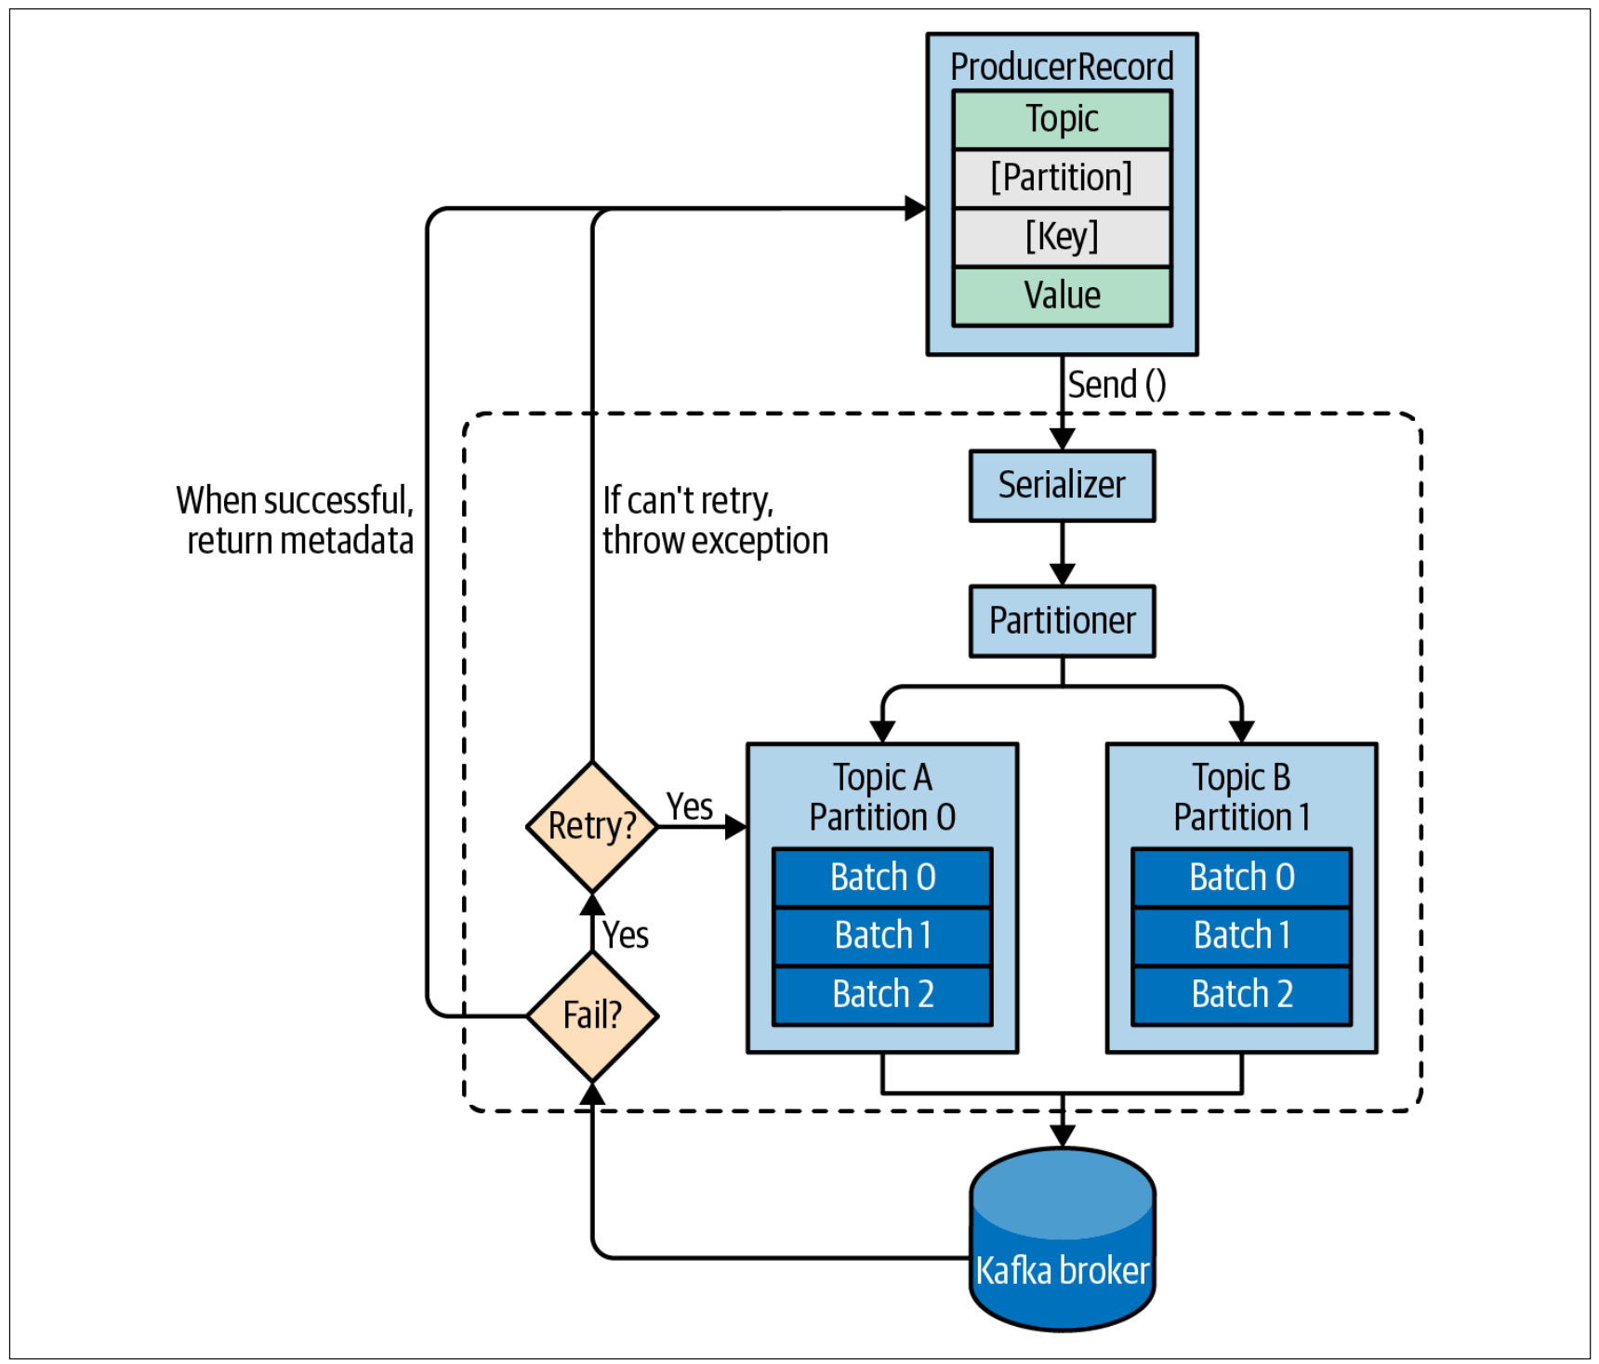
Producers
Setting up a producer:
bootstrap.servers, key.serializer, value.serializer
Building Producer Records:
Topic, Value, Partition (optional), Key (optional), Headers (optional)
Serializing
Batching
By size, by time
Partitioning
Sending and retrying on transient errors
Notes:
Explain the fields of a producer record:
1 – High level data segmentation. Consumers register in specific topic
2 – Each partition is almost like a separate queue where the events are ordered
3 – Key is what is used to calculate the partition. If no key is specified a partition is randomly assigned
4 – Data being exchanged
Batching: network overhead and network round trips
Why do we need key/value serializers in the producer: serialization will be covered in more detail ahead. Talk about the language independence allowed by working with only bytes

Slide 24
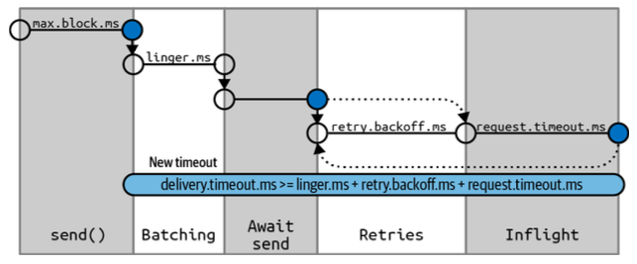
Producers
Important Configurations:
delivery.timeout.ms:
This configuration will limit the amount of time spent from the point a record is ready for sending (send() returned successfully and the record is placed in a batch) until either the broker responds or the client gives up, including time spent on retries.
compression.type:
By default, messages are sent uncompressed. This parameter can be set to snappy, gzip, lz4, or zstd,
batch.size:
When multiple records are sent to the same partition, the producer will batch them together. This parameter controls the amount of memory in bytes (not messages!) that will be used for each batch.
max.request.size:
This setting controls the size of a produce request sent by the producer. It caps both the size of the largest message that can be sent and the number of messages that the producer can send in one request
Notes:
delivery.timeout.ms:
This configuration will limit the amount of time spent from the point a record is ready for sending (send() returned successfully and the record is placed in a batch) until either the broker responds or the client gives up, including time spent on retries.
compression.type:
By default, messages are sent uncompressed. This parameter can be set to snappy, gzip, lz4, or zstd,
batch.size:
When multiple records are sent to the same partition, the producer will batch them together. This parameter controls the amount of memory in bytes (not messages!) that will be used for each batch.
max.request.size:
This setting controls the size of a produce request sent by the producer. It caps both the size of the largest message that can be sent and the number of messages that the producer can send in one request

Slide 25
Producers
What is serialization and why do we need it?
To send information through the network! It convert the information in memory to a sequence of bytes that can be sent over the network.
Examples: Avro, Protobuf, JSON
Notes:
To send information through the network! It convert the information in memory to a sequence of bytes that can be sent over the network.
Examples: Avro, Protobuf, JSON

Slide 26
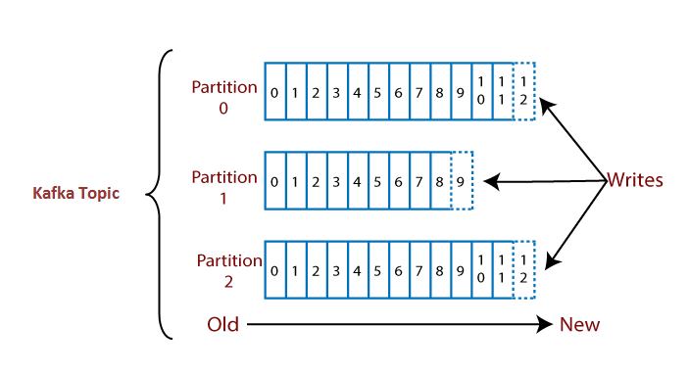
Producers
Why do we need partitions?
Scalability
Resiliency
Ordering
Notes:
Scalability
Resiliency
Ordering
Types of partitioning
- Default-partitioning if no key is specified -> Round robin? What is it and why used?
- Key based portioning -> hashing -> similar to hash-maps!
- Custom-partitioning

Slide 27
Producers
What is the advantage of having the message’s key defining the partition in which the message will be placed?
Ordering and horizontal scaling!
Notes:
1. We guarantee that messages with the same key are processed in order. For example: in an e-commerce system all events related to the same order will be processed in the appropriate order

Slide 28
Producers
What tradeoffs are being made with batching?
Network Overhead
Network Round-trip
Delayed Messages
Notes:
Network Overhead
Network Round-trip
Delayed Messages
The network overhead is lower and we have less network round-trips but the messages are delivered with a longer delayed

Slide 29
Producers
Message sending strategies:
Fire-and-forget
Synchronous
Asynchronous
Notes:
Throughput vs Durability

Slide 30
Producers
Can you match each type of with the appropriate system?
Message sending strategies:
Fire-and-forget
Synchronous
Asynchronous
Systems:
High-throughput e-commerce system
Low-throughput e-commerce system
Sensor network
Fire-and-forget -> Sensor network
Synchronous -> Low-throughput e-commerce system
Asynchronous -> High-throughput e-commerce system
Notes:
Fire-and-forget: sensor network (if we lose messages is not critical)
Synchronous: low-throughput e-commerce system (easier to reason about but lower performance due to blocking nature)
Asynchronous: high-throughput e-commerce system (harder to reason about higher performance due to non-blocking nature)

Slide 31
Producers
What are tradeoffs of the existent acknowledgments strategies?
acks = 0
acks = 1
acks = all (default)
Throughput vs delivery assurance
Producer latency vs End-to-end latency
Notes:
Define the number of acks the producer needs to receive before considering the message as delivered
0: None
1: Only the leader (no redundancy)
2: All instances – leader and replicas
End-to-end latency is not affected because consumers will only consume committed messages – messages are only considered committed when all replicas acknowledge them independently of the ack configuration on the producer

Slide 32
Coffee Break
5 minutes

Slide 33
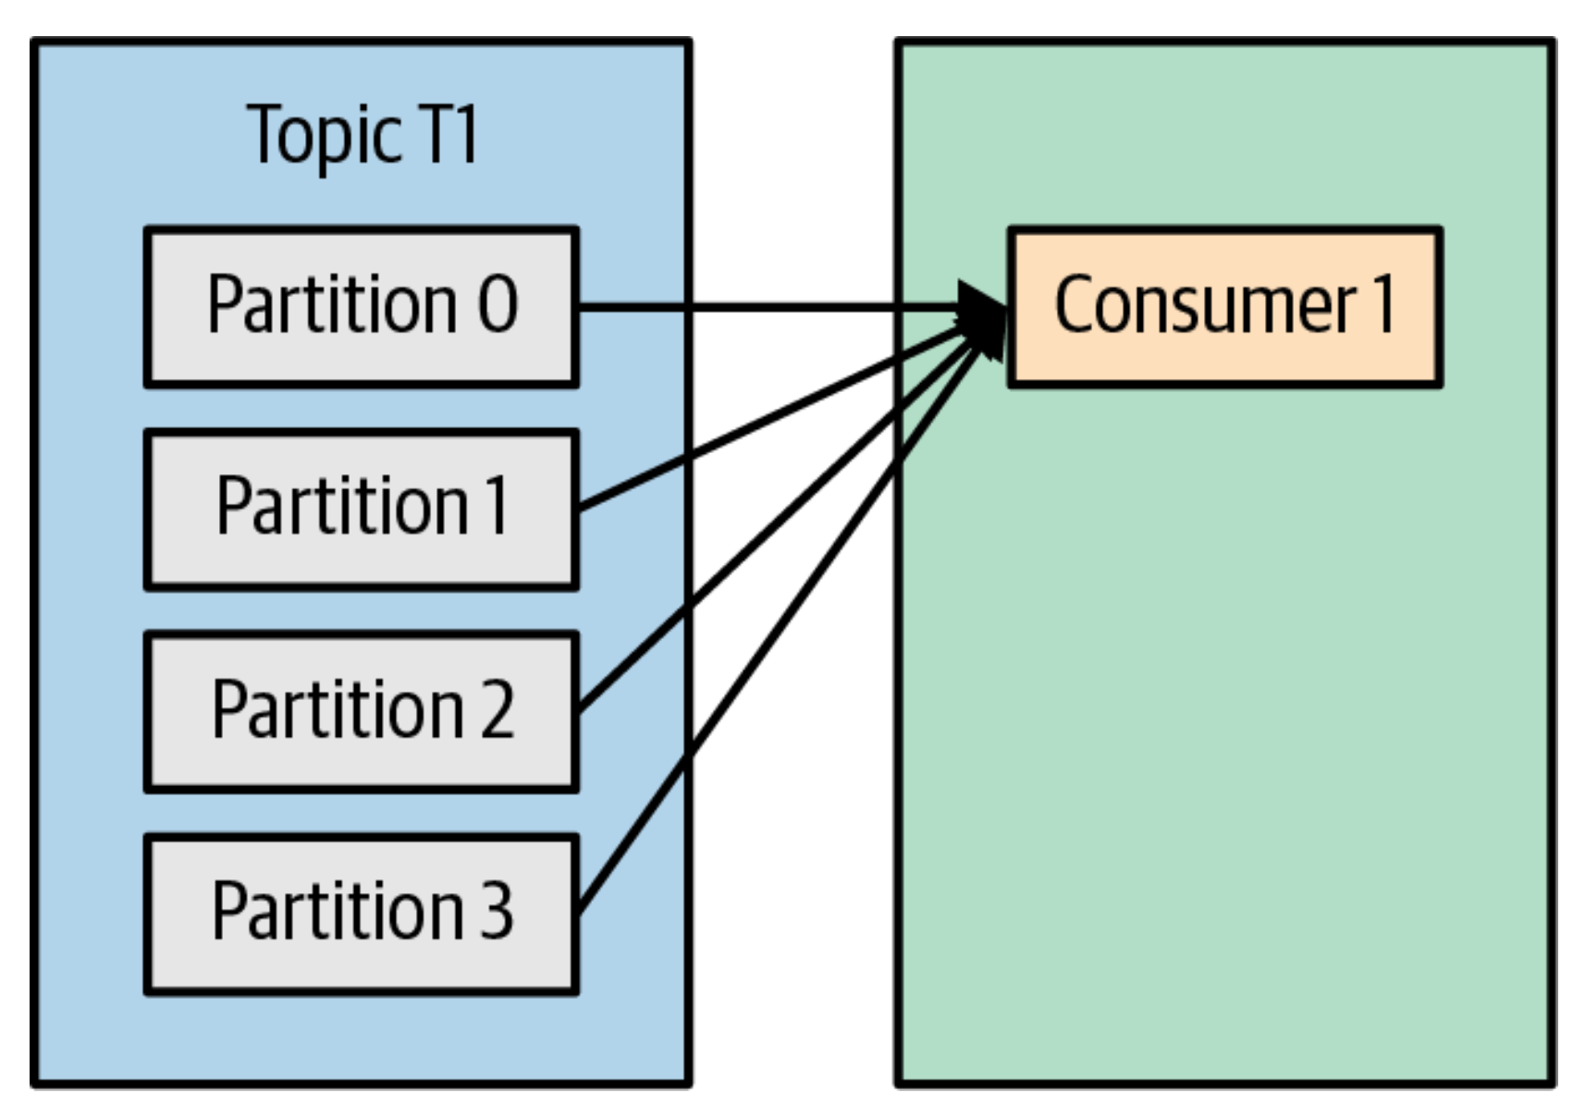
Consumers
Setting up a consumer:
bootstrap.servers, key.deserializer, value.deserializer
Why do we need deserializers?
To convert the information sent from a producer to a format the consumer can interpret

Slide 34
Consumers
Important Configurations:
fetch.min.bytes:
This property allows a consumer to specify the minimum amount of data that it wants to receive from the broker when fetching records, by default one byte.
fetch.max.wait.ms:
This property lets you specify how long to wait for fetch.min.bytes.
fetch.max.bytes:
This property lets you specify the maximum bytes that Kafka will return whenever the consumer polls a broker (50 MB by default).
Notes:
Talk about tradeoffs between compression effort and latency

Slide 35
Consumers
Important Configurations:
max.poll.records:
This property controls the maximum number of records that a single call to poll() will return. Use this to control the amount of data (but not the size of data)
enable.auto.commit
This parameter controls whether the consumer will commit offsets automatically, and defaults to true.
auto.offset.reset (earliest, latest [default], none):
This property controls the behavior of the consumer when it starts reading a partition for which it doesn’t have a committed offset, or if the committed offset it has is invalid
Notes:
Talk about tradeoffs between compression effort and latency

Slide 36
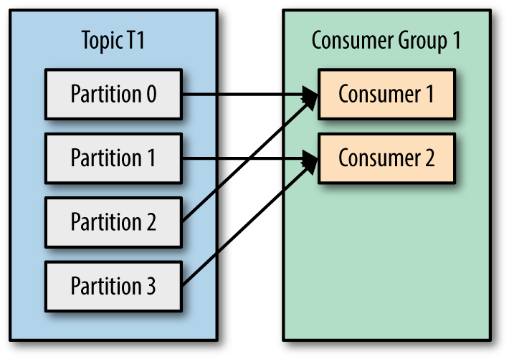
How do we scale message consumption?
Increasing partitions and consumers within each consumer group
Notes:
Increase number of partitions and consumers in consumer groups!

Slide 37
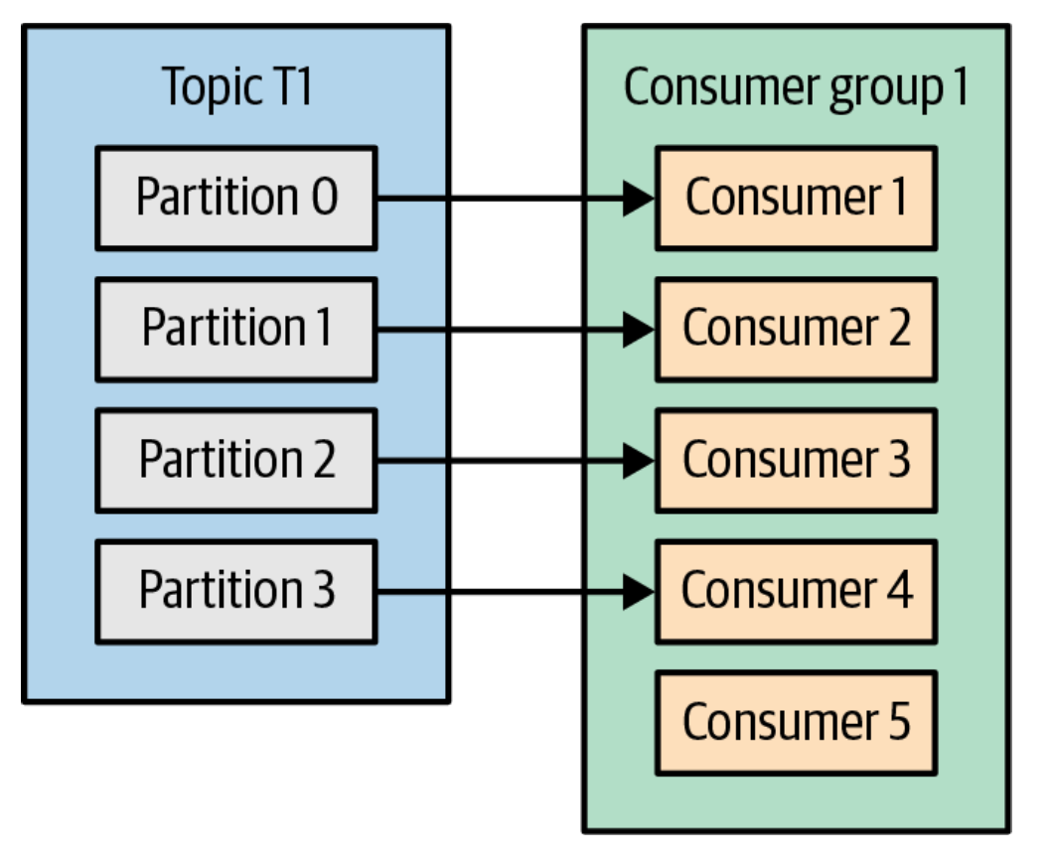
Consumers
Can we have multiple consumers in the same consumer group reading from the same partition?
Nope! Why?
Ordering guarantees!
Notes:
No due to concurrency issues
How would those issue occur if the messages are ordered and fetched by order?

Slide 38
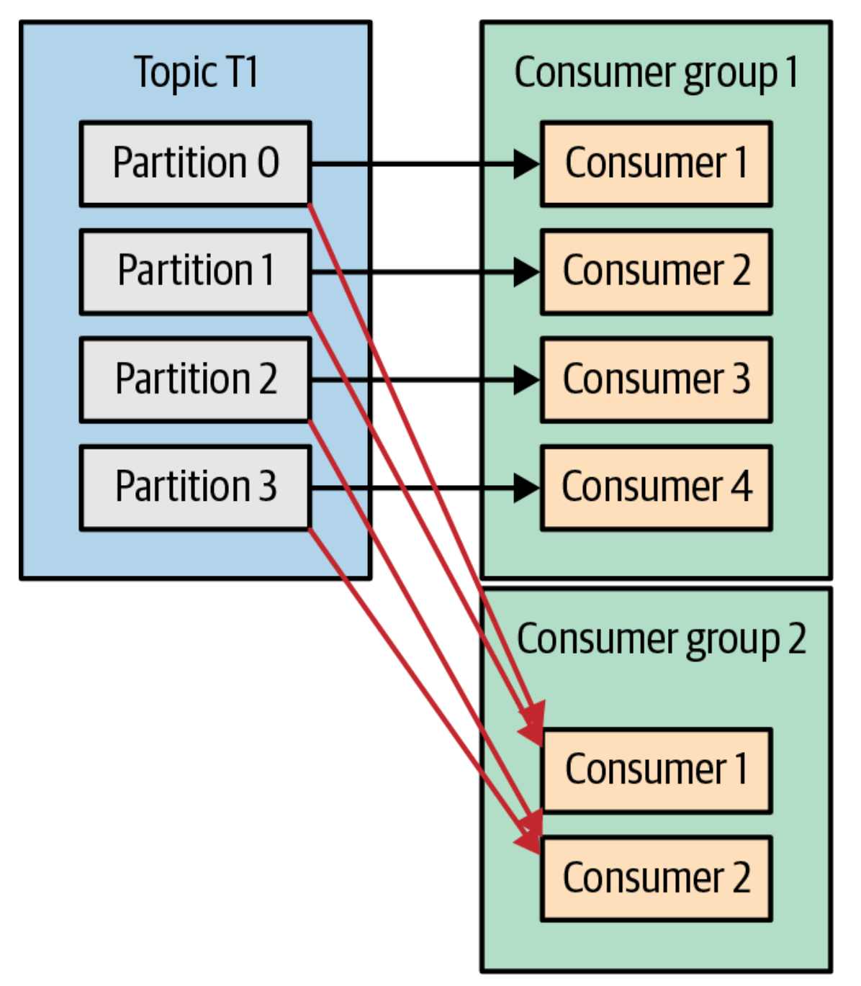
Consumers Groups
What are they?
Why do we need them?
Segregate message consumption!
Notes:
Segregate message consumption!

Slide 39
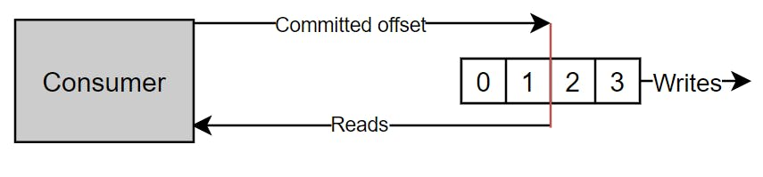
Consumers
What is offset committing?
Who’s responsible for it?

Slide 40
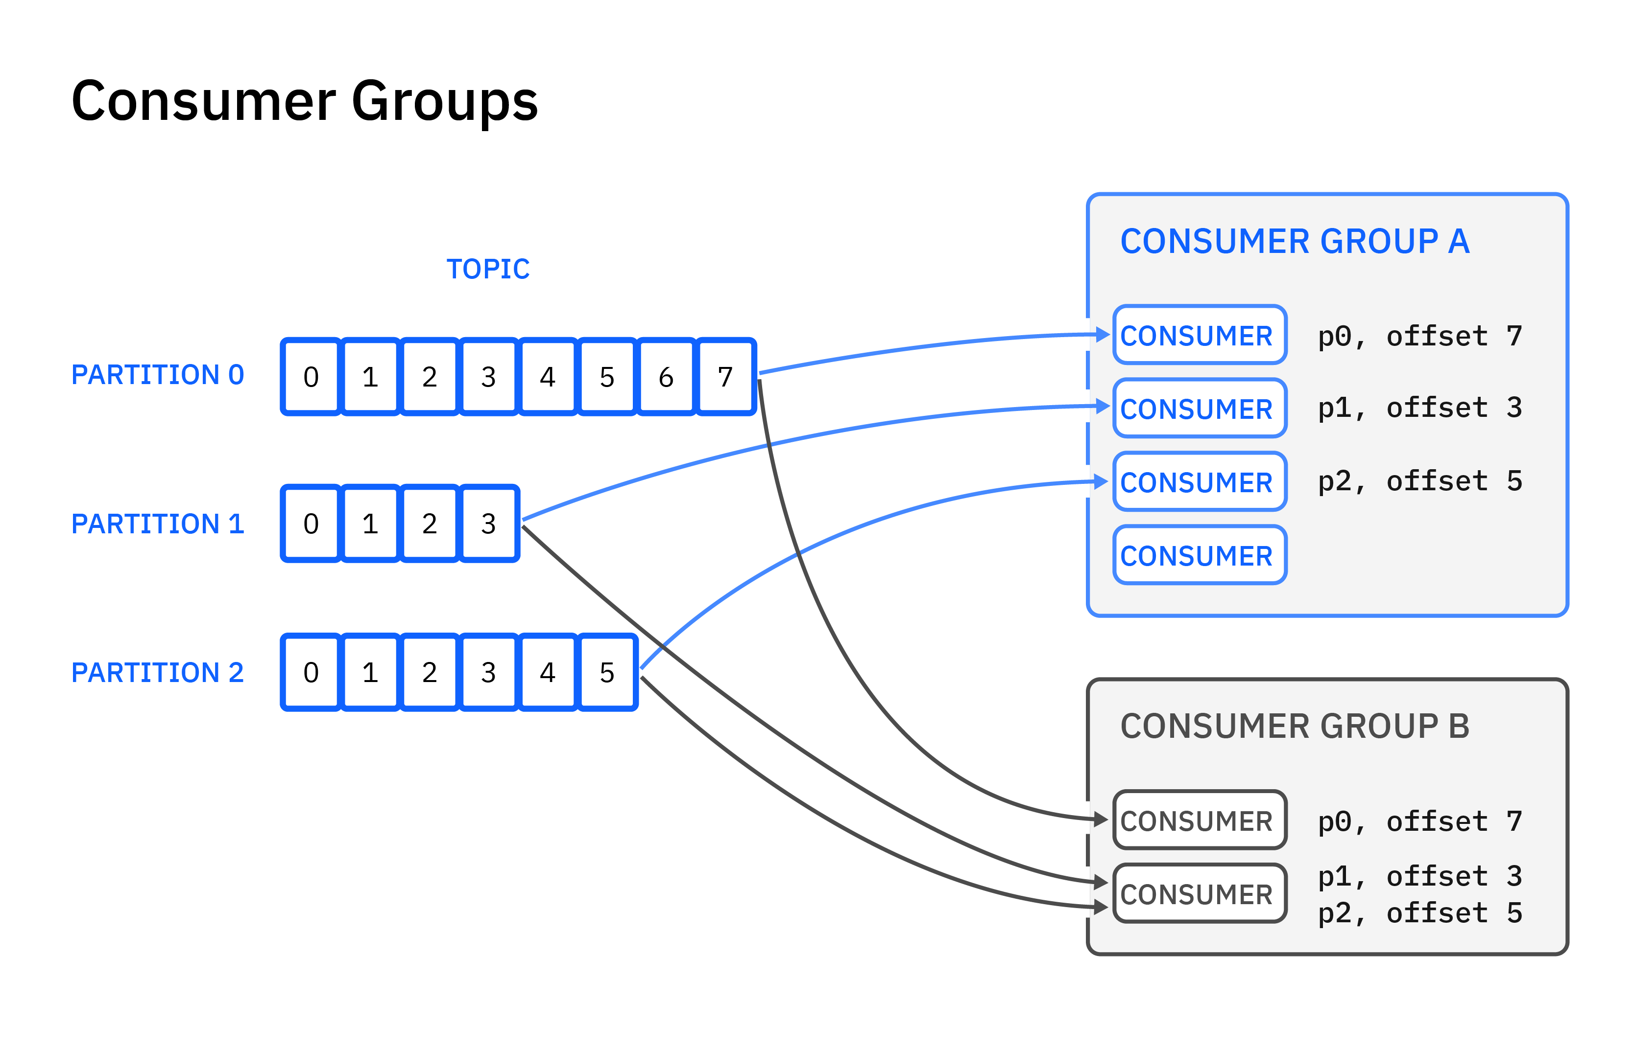
Consumers
How do consumers know from where should they start to read?
Kafka broker keeps track of the offsets for each partition in each consumer group
Notes:
Kafka broker keeps track of the offsets for each partition in each consumer group

Slide 41
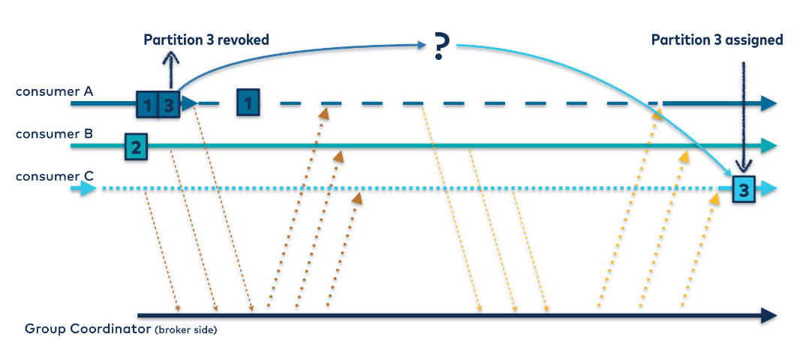
Consumer Groups Rebalances
Brokers removed/added to the Kafka cluster
Changes on the topic on the Kafka cluster
Consumers removed/added to the consumer group

Slide 42
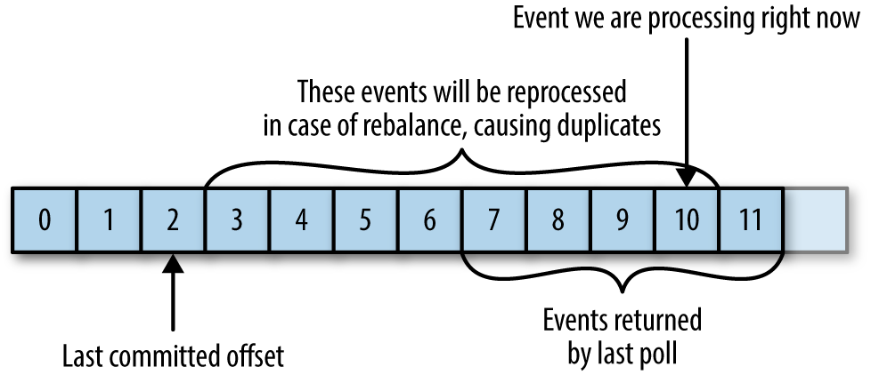
Consumers
Importance of idempotence (idempotent reads)

Slide 43
Partition Hot Keys
What happens if one partition has much more data than the others? How do we fix it?
One of the consumers will much more overloaded than the remaining. This could lead to lag in that specific partition
Notes:
Make the parallel with hash-maps collisions
Maybe reconsider choosing a distinct partition key or increase the number of partitions

Slide 44
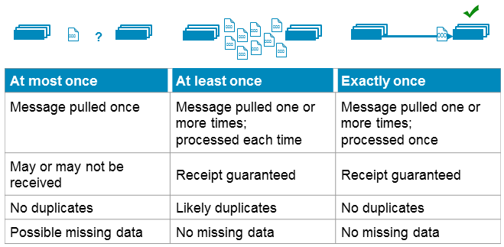

Delivery Semantics
Latency
Durability
Idempotence
How can we control this?
enable.auto.commit
If you want to know more about the intricacies of exactly-once semantics you can read this:
Notes:
At-most-once:
- can lose messages
- the offset is committed as soon as the batch arrives and before the message being processed. If the processing fails that message will be lost
At-least-once – default:
- can read the same message multiple times. In case of doubt the producer will retry to send the message
- the offset is committed only after the message being successfully processed. If the offset commit fails that message will be consumed again leading to duplication.
- we need to have an idempotent consumer in this case of the at-least once.
Exactly-once:
- Some say that this is impossible :D
- The message is delivered exactly one time. To achieve this we need to configure both the consumers and producers in a very particular way
- I will not go into this in detail because it is a very complex topic to address in this presentation: https://www.linkedin.com/pulse/kafka-transactions-part-1-exactly-once-messaging-rob-golder/

Slide 45

Kafka reliability guarantees
Guaranteed ordered messages within the same partition for the same producer.
Committed messages are not lost as long as one replica is up.
Messages are considered commited once sent to all in-sync replicas.
Consumers can only read messages that are committed.
Notes:
Messages are considered commited once sent to all the replicas holding the data of a given partition

Slide 46
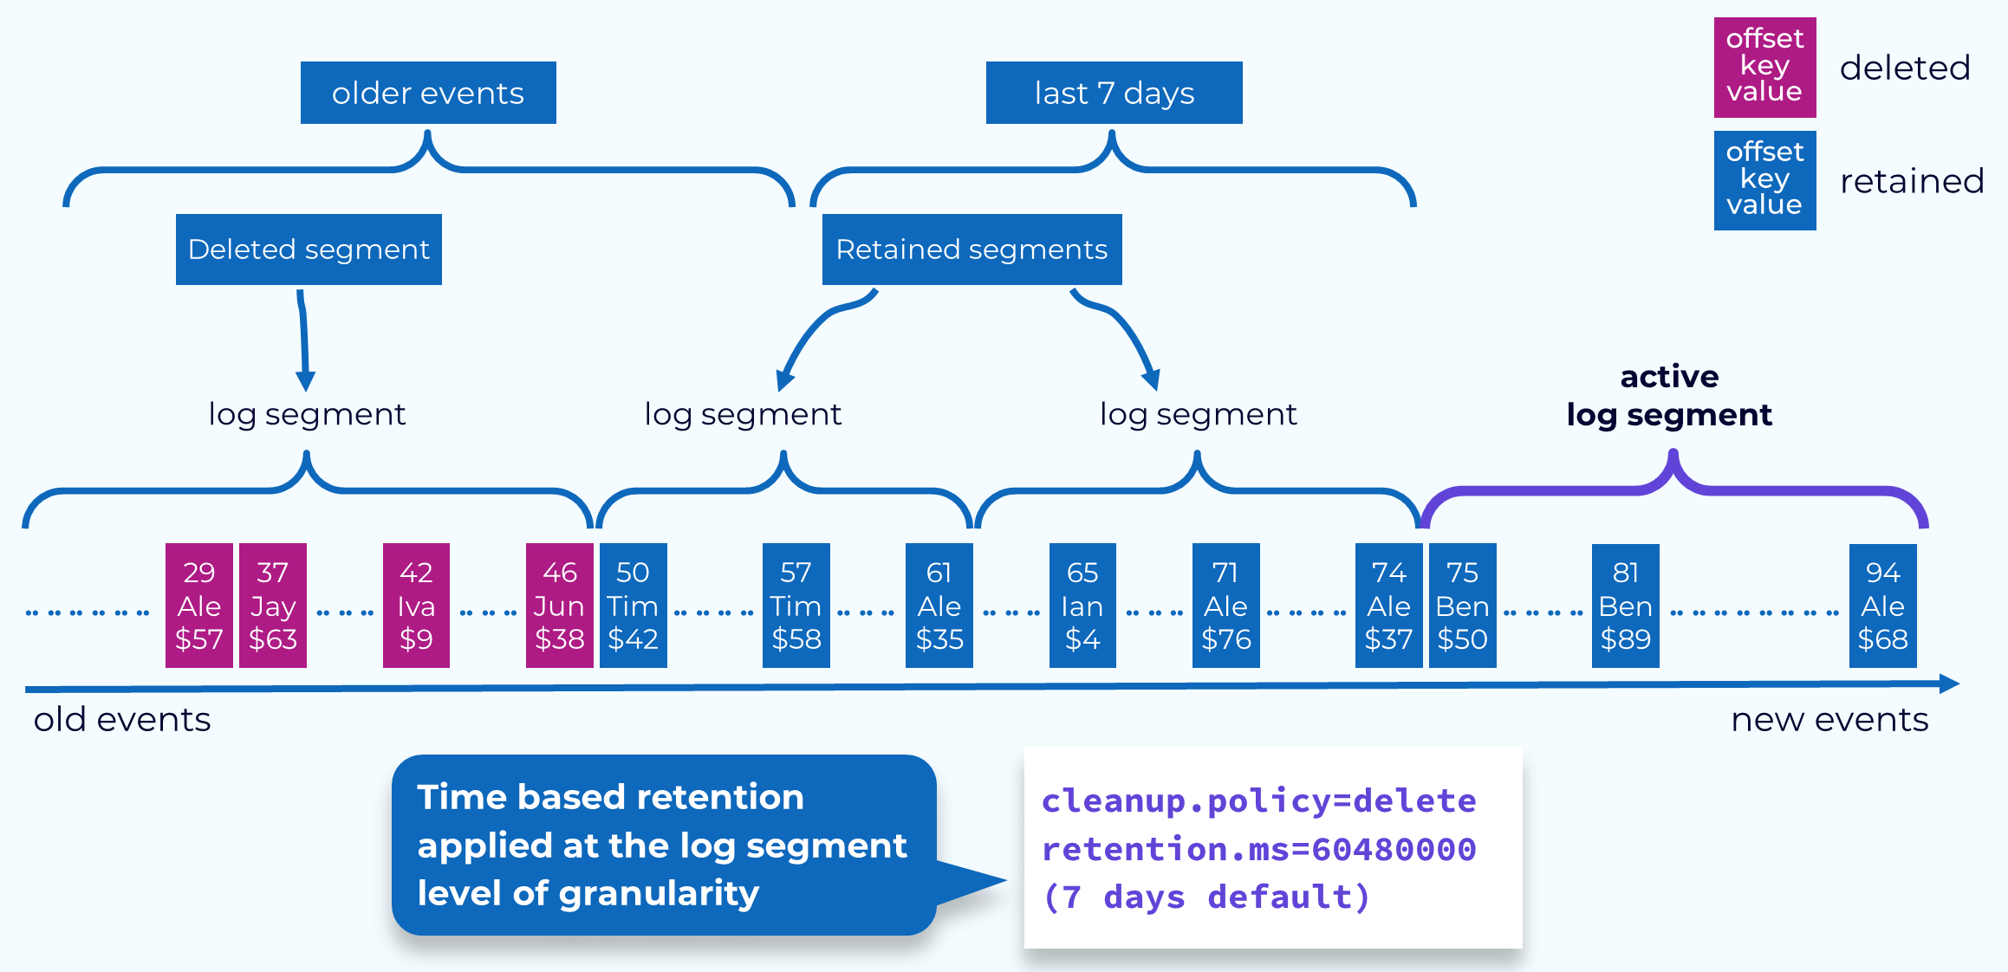
A note on retention
log.retention.hour: The number of hours to retain log segments. Determines how long data is kept in Kafka.
log.retention.bytes: The maximum size of log data to retain. Older segments will be deleted to meet this limit.

Slide 47
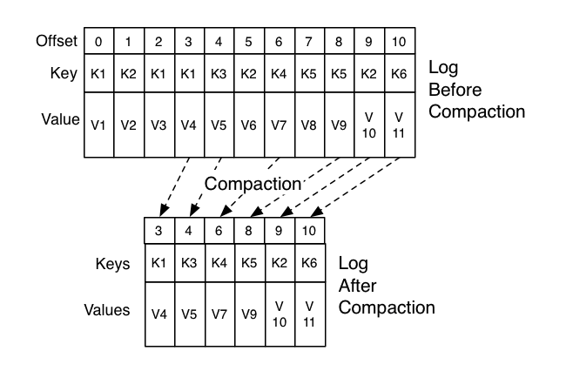
A note on compaction
Retain at least the last known value for each message key within the log of data for a single topic partition.
It can have multiple records for the same key at a given instant since the cleaning procedure runs periodically
Can be used to restore state by consuming from the earliest offset when bootstrapping a consumer.

Slide 48
Coffee Break
5 minutes

Slide 49
6. Lab Time

Slide 50
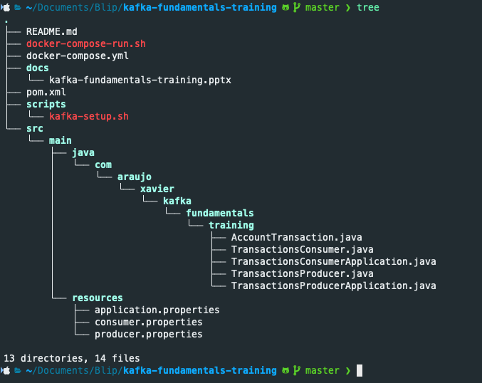
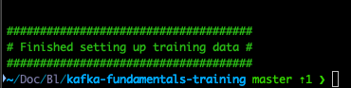
Implementing a basic Kafka producer and consumer
Go to this repo and download the project:
https://github.com/XavierAraujo/kafka-fundamentals-training
Run mvn clean install to guarantee that everything is working as expected
Guarantee that you have Docker and Docker-Compose installed (and maybe DockerDesktop up and running if you have a Macbook) and that you have no other Kafka or Zookeeper servers running on your PC.
Execute the following script to setup the required infrastructure: ./docker-compose-run.sh
(Run this script instead of ‘docker-compose up’ because this script sets up some extra stuff required for this training)
guarantee you get this

Slide 51

1. Idempotency: how do you deal with duplicated records
2. Message sending strategy: fire-and-forget, synchronous, asynchronous?
3. Delivery guarantees (at-least-once, at-most-once)
4. Offset committing strategy (manual/automatic)
5. Serialization mechanism (type safety, performance, simplicity, distinct platform inter-operability)
6. Partitioning strategy and ordering
7. Poison pills

Slide 52
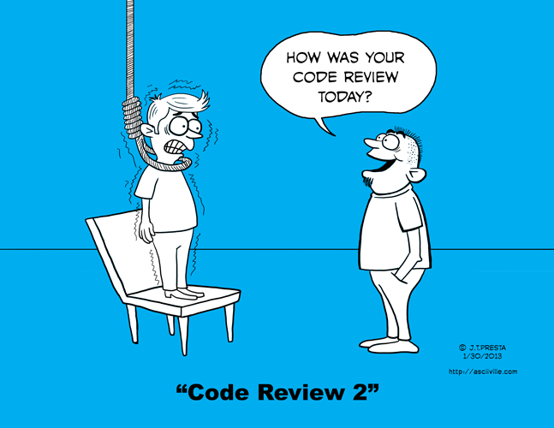
And now a bit of code review

Slide 53
What is the message partitioning strategy being applied? Is that the best approach? Why?
Notes:
Demo branch:
Using transaction ID. Guarantees ordering

Slide 54
How is serialization being done? Is that the best approach? What are the tradeoffs?
Notes:
Demo branch:
Using JSON. Tradeoff between complexity, human readability and performance in terms of serialization size

Slide 55
What happens if someone pushes wrongfully serialized data to the topic (Poison Pill)?
Notes:
Demo branch:
The consumer gets stuck on that offset

Slide 56
How is offset committing being handled. Is that the best approach? What happens if we fail to process a transaction?
Notes:
Demo branch:
Auto-commmit. At-most-once delivery guarantees. We can fail processing transactions and lost them forever.

Slide 57
What happens if we process the same message twice?
Notes:
Demo branch:
It will be count the same transaction twice. Not the best approach. We can use transaction-id to prevent this.

Slide 58
What are the delivery semantics used here? Are they the most appropriate ones?
Notes:
At-most-once delivery guarantees

Slide 59
What is the message sending strategy used? Is it the most appropriate?
Notes:
Demo branch:
It will be count the same transaction twice. Not the best approach. We can use transaction-id to prevent this.

Slide 60
7. Kafka CLI Tools

Slide 61

Kafka CLI Tools
kafka-configs
kafka-console-consumer
kafka-console-producer
kafka-consumer-groups
kafka-get-offsets
kafka-topics
kcat (not a native Kafka tool)

Slide 62
Lets practice!
How many and which topics exist in the local broker?
kafka-topics --bootstrap-server 127.0.0.1:9092 –list [transactions, blippers, loans]
Can you create a topic on the local broker?
kafka-topics --bootstrap-server 127.0.0.1:9092 --create --topic dummy-topic
How many partitions has the ‘loans’ topic and what is its replication factor?
kafka-topics --bootstrap-server 127.0.0.1:9092 --describe --topic loans [5 partitions]
Can you delete a topic?
kafka-topics --bootstrap-server 127.0.0.1:9092 --delete --topic dummy-topic

Slide 63
Lets practice!
Can you duplicate the number of partitions of the ‘blippers’ topic?
kafka-topics --bootstrap-server 127.0.0.1:9092 --alter --topic blippers --partitions 20
What is the retention period of the ‘transactions’ topic?
kafka-configs --bootstrap-server 127.0.0.1:9092 --describe --entity-type topics --all [1209600000]
Can you change the retention period of the ‘transactions’ topic to 1 hour?
kafka-configs --bootstrap-server 127.0.0.1:9092 --alter --topic transactions --add-config retention.ms=3600000
Can you delete the messages from a topic?
kafka-configs --bootstrap-server 127.0.0.1:9092 --entity-type topics --alter --entity-name dummy-topic --add-config retention.ms=1
kafka-configs --bootstrap-server 127.0.0.1:9092 --entity-type topics --alter --entity-name dummy-topic --add-config retention.ms=36000

Slide 64
Lets practice!
See information about consumer groups
kafka-consumer-groups --group kafka-fundamentals-training-group-1 --describe --bootstrap-server localhost:9092
Reset consumer groups offsets
kafka-consumer-groups --bootstrap-server kafka-host:9092 --group kafka-fundamentals-training-group-1 --reset-offsets --to-earliest --all-topics --execute

Slide 65
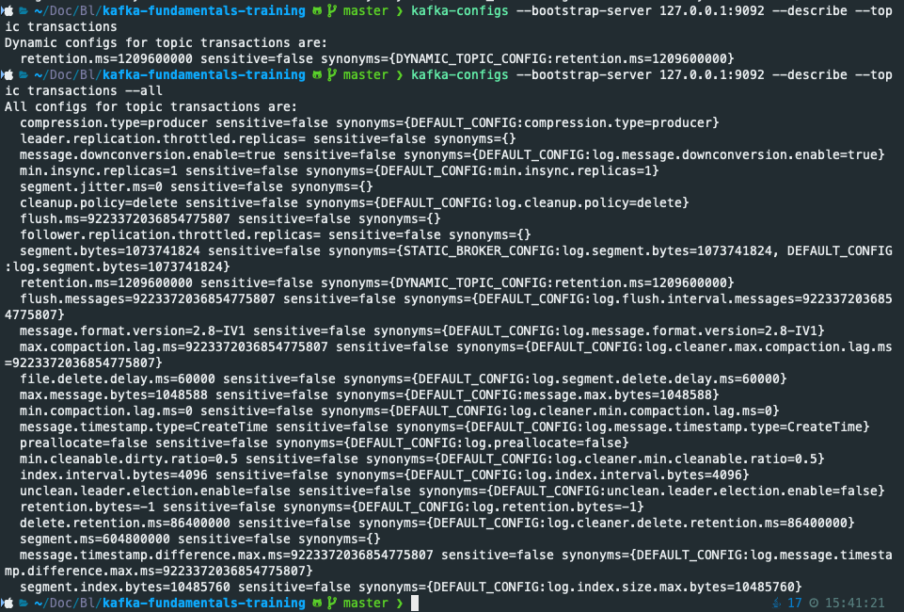
A note on dynamic and static properties
Dynamic properties can be changed without requiring restarts
Static properties need restarts
Notes:
Configs modified using the kafka-configs tool are persistent and remain through broker restarts.

Slide 66
8. Kafka Related Projects

Slide 67
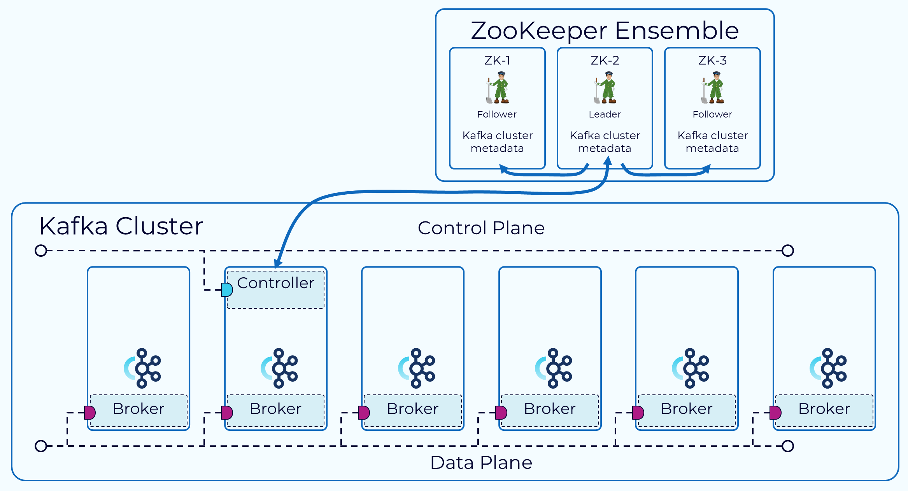
Zookeeper
Cluster Coordination
Partition Leader Election
Metadata Management
Configuration Management
Kafka Brokers Registration and Liveness
Quorum-based Consensus
Controller Election
Dynamic Broker Reconfiguration

Slide 68
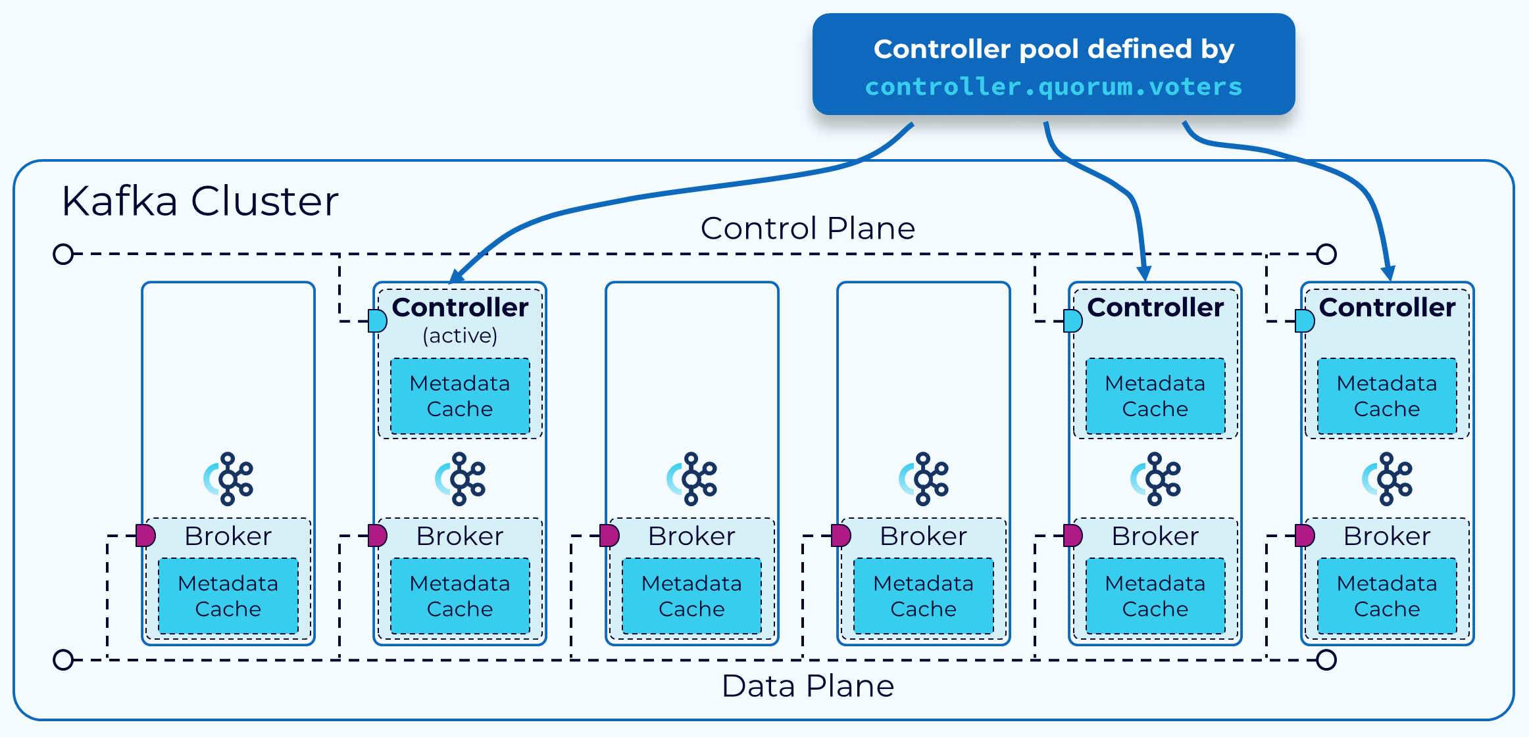
Kraft Mode

Slide 69
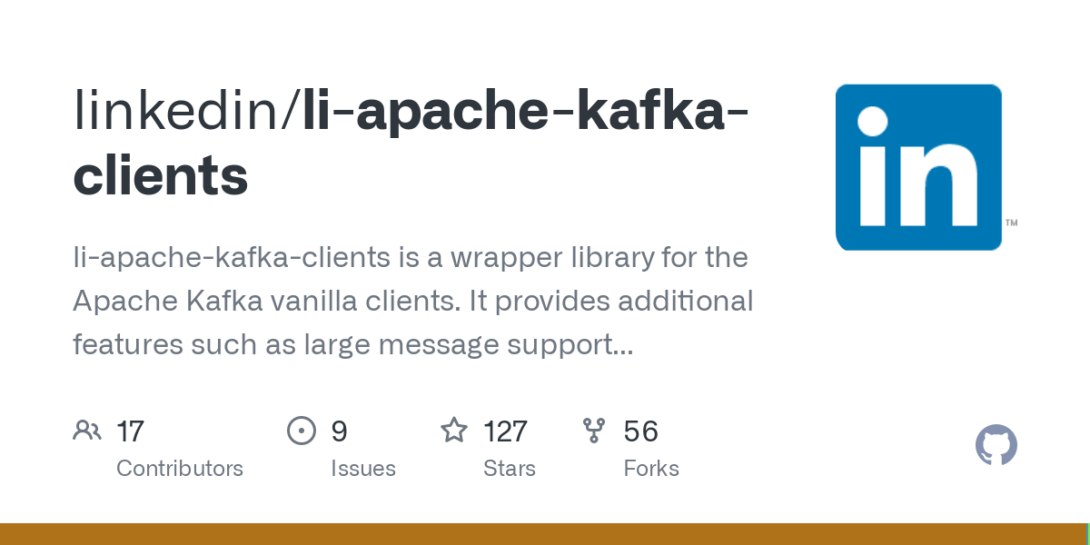
Apache Kafka-Clients

Slide 70
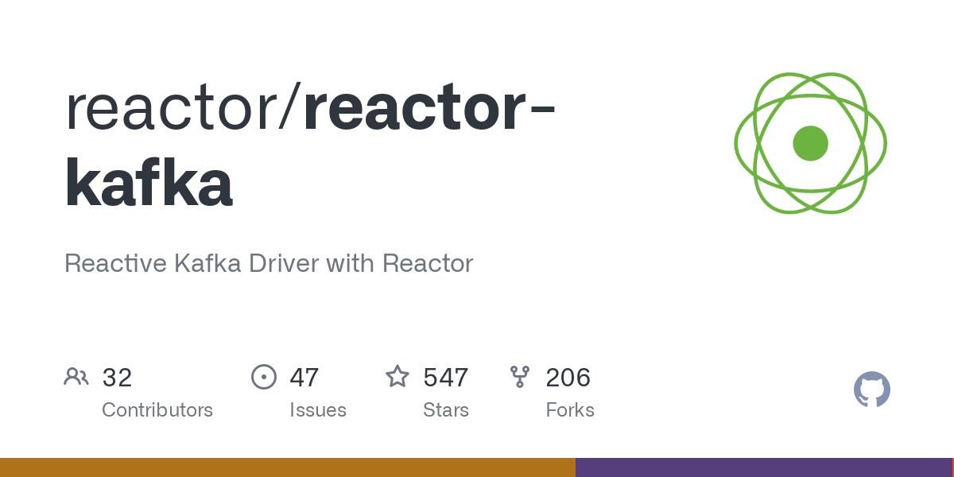
Reactor-Kafka
Kafka consumer and producer implemented based
on Reactive-Streams:
Functional interface (Similar to Java streams)
Non-blocking back-pressure (only fetch data as quick as you can process it)
End-to-end reactive pipeline (back-pressure will be applied every stage of the pipeline)
Notes:
Functional interface: allow for applications to be written in a functional-style
Non-blocking back-pressure: Back-pressure can be applied easily to the whole pipeline, limiting the number of messages in-flight and controlling memory usage. Messages flow through the pipeline as they are available, with Reactor taking care of limiting the flow rate to avoid overflow, keeping application logic simple.

Slide 71
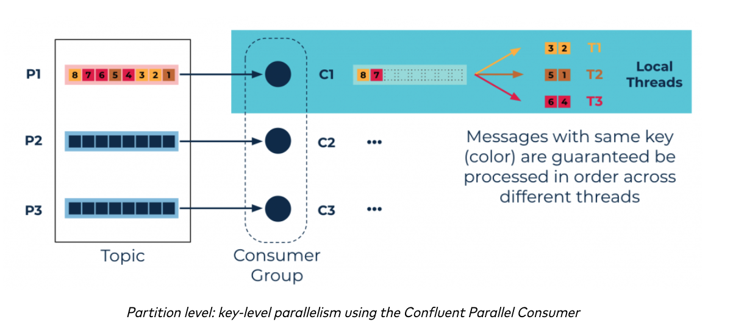
Confluent Parallel Consumer
Notes:
Functional interface: allow for applications to be written in a functional-style
Non-blocking back-pressure: Back-pressure can be applied easily to the whole pipeline, limiting the number of messages in-flight and controlling memory usage. Messages flow through the pipeline as they are available, with Reactor taking care of limiting the flow rate to avoid overflow, keeping application logic simple.

Slide 72
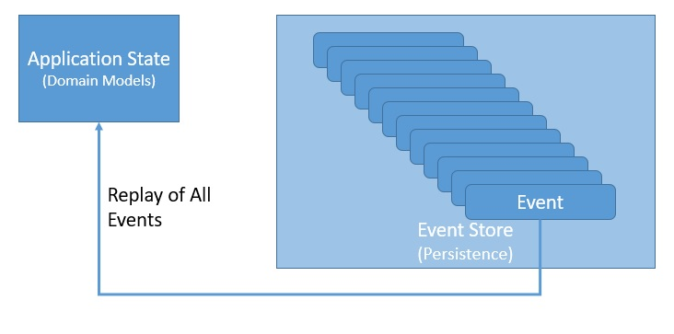
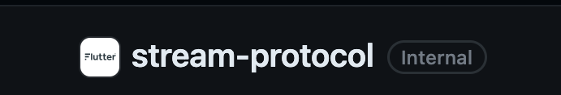
Event-Sourcing & Stream-Protocol
What it is event-sourcing?
How can we do it using Kafka?
Notes:
https://github.com/Flutter-Global/stream-protocol
Explain event-sourcing and give the bank example. Talk a bit of the advantages of event-sourcing -> operation history tracking
Talk about how we could do event-sourcing using Kafka by reading from earliest. Talk about the performance implications of this approach – reading everything from start.
Talk about how we can achieve better performance with StreamProtocol -> talk about the issues of keeping everything in-memory

Slide 73
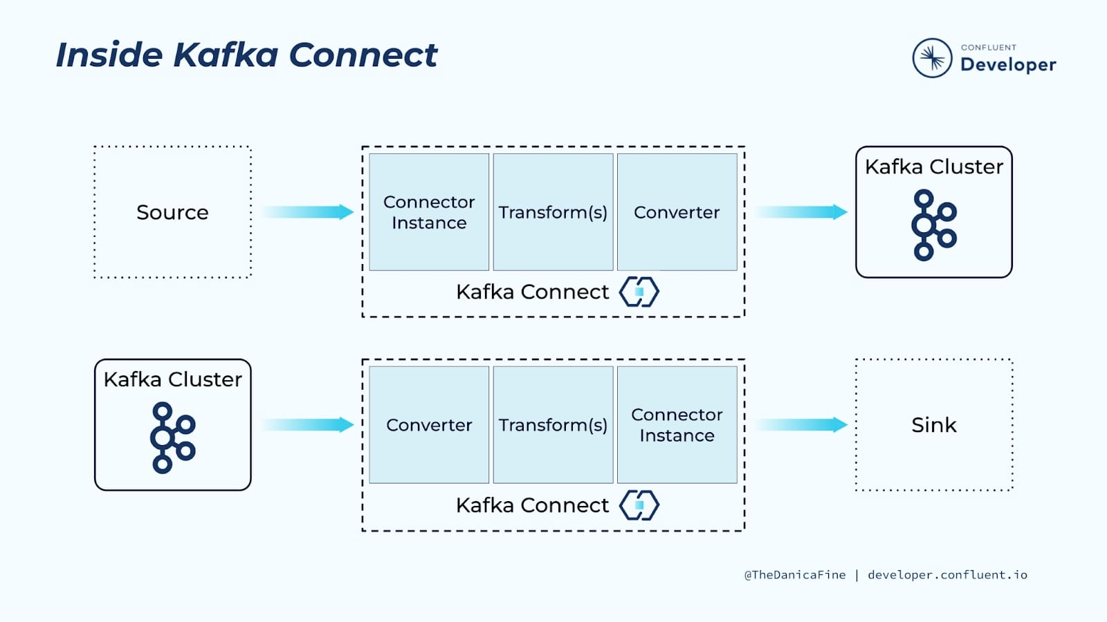
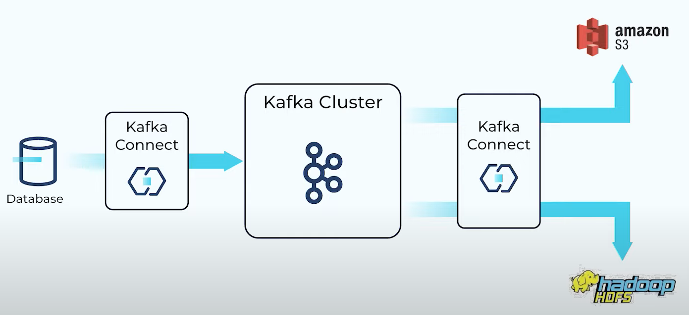
KCD - Kafka Connect
How does it operate?
Retrieve data from a source
Transform the data (optional)
Convert it to the desired format and place it on a Kafka cluster
Export data from Kafka cluster to a sink
Advantages
Real-time streaming capabilities
Decoupling between sources and sinks
No code required – configuration-based
Auto-scaling out of the box
Handles serialization

Slide 74
09. A Note on Serialization

Slide 75
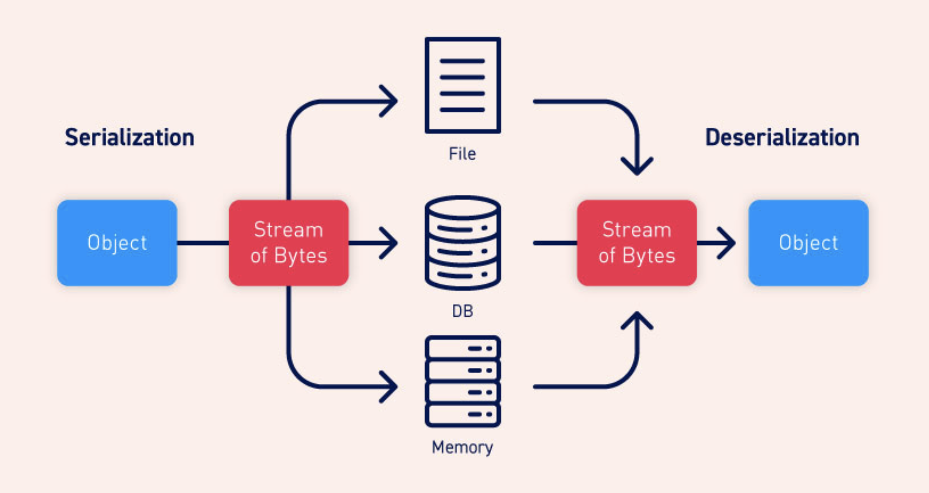
Producer-Consumer Contracts
Is it possible to redefine contracts without breaking existent consumer? Won’t that lead to poison pills?

Slide 76
Serialization Compatibility
Backard Compatibility: Newer code can read data that was written by older code
Forward Compatibility: Older code can read data that was written by newer code

Slide 77
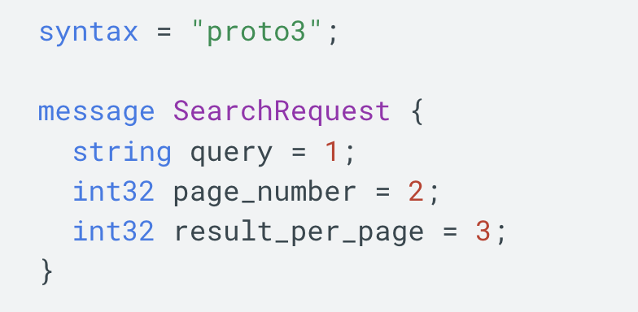
Rules for Compatibility
Keep field tag number unchanged (names can change) – required for forward and backward compatibility
Associate new fields with a new tag number – required for forward compatibility
New fields must always be optional or have a default value – required for backward compatibility
Only optional fields should be removed, and tag numbers cannot be reused – required for forward compatibility
Field’s datatype can (in some cases) be changed. There is however a risk that values will lose precision or get truncated

Slide 78
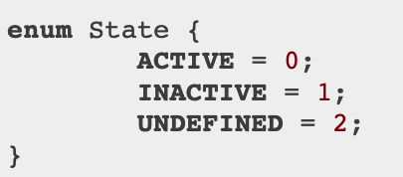
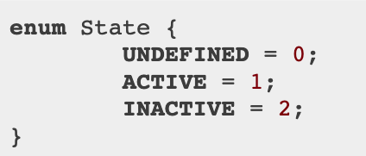
Serialization Compatibility vs
Logic Compatibility
What’s the problem here?
Old code will interpret the enumeration values sent by new code in a wrong way

Slide 79

Please… Don’t use Java serialization!
Not language agnostic.
Retro-compatibility not guaranteed between Java versions.
No serialization version control.
Not performant in terms of time or serialization size.

Slide 80
10. Final Quiz
(to check if you can put Kafka on your CV 😂 )

Slide 81
Can we have multiple producers for the same topic? What about consumers?
Yes! That is one of the main features of Kafka that allows us to have loose coupling
Notes:
Yes! That is one of the main features of Kafka that allows us to have loose coupling

Slide 82
How is ordering guaranteed in Kafka? What do we have to take into consideration when designing a system which required event ordering?
Kafka guarantees ordering within each partition of a given topic. We should guarantee that messages that should be processed in order are sent by with the same partition key associated.
Notes:
Kafka guarantees ordering within each partition of a given topic. We should guarantee that messages that should be processed in order are sent by with the same partition key associated.

Slide 83
What happens if the number of partitions is different than the number of consumers? How does the Kafka cluster manages that?
If the number of partitions is higher than the number of consumers some consumers will process multiple partititions.
If the number of partitions is lower than the number of consumers some consumers will be idle.
Notes:
If the number of partitions is higher than the number of consumers some consumers will process multiple partititions.
If the number of partitions is lower than the number of consumers some consumers will be idle

Slide 84
If I have two applications consuming from the same topic how do I guarantee that each one of them processes all messages from the topic?
By assigning them distintic consumer groups
Notes:
By assigning them distintic consumer groups

Slide 85
What should we use as the partition key in a e-commerce website which emits events to a Kafka topic about the status of the orders?
The order ID would be a good example. That way all messages related to that order end up in the same partition and with that we can guarantee ordering.
Notes:
The order ID would be a good example. That way all messages related to that order end up in the same partition and with that we can guarantee ordering.

Slide 86
In which type of systems is the fire-and-forget message sending strategy appropriate?
In systems where the high throughput is the one of main requirements of the system and we don’t mind losing a few messages to achieve it.
Notes:
In systems where the high throughput is the one of main requirements of the system and we don’t mind losing a few messages to achieve it.

Slide 87
What happens if a consumer is offline? Are the messages lost?
It depends on the retention period of the topic and for how long was the consumer offline.
Notes:
It depends on the retention period of the topic and for how much time was the consumer offline.

Slide 88
How do the consumers keep track of the messages they already consumed?
They periodically commit the offset of the messages that they have processed and the Kafka cluster keeps track of that information. When the consumer starts the Kafka cluster will start sending him messages starting from to the last commited offset.
Notes:
They periodically commit the offset of the messages that they have processed and the Kafka cluster keeps track of that information. In the bootstrap of the consumer this information is fetched from the cluster.

Slide 89
What does it mean for a consumer to be idempotent? Should we program our consumer to be idempotent?
It means that it can process the same message multiple times without side-effects. Usually yes because this is a common scenario in Kafka based systems since the at-least-once delivery semantics is the one usually being used.
Notes:
It means that it can process the same message multiple times without side-effects. Usually yes because this is a common scenario in Kafka based systems since the at-least-once delivery semantics is the one usually being used.

Slide 90
What can you do if a given consumer group did not correctly handle some messages due to a bad offset commit strategy?
We can reset the consumer-group offset to earlier (oldest messages in the topic). This requires idempotent consumers though.
Notes:
We can reset the consumer-group offset to earlier (oldest messages in the topic). This requires idempotent consumers though.

Slide 91
What happens if we set the replication factor of a topic to 1?
If a broker which is leader of that topic partition goes down the information of that partition is lost
Notes:
If a broker which is leader of any partition of that topic goes down the information of that partition is lost

Slide 92
Thank you for attending!
Please fill out the feedback form! 🥺
❤️

